Slide 1

Mood Picture
Project I – Masters in Creative Computing and AI
Author: Alan Caetano.

Slide 2

Goals
The main goal of this project is to make people reflect about their mood.

Slide 3

GOALS
Raise awareness about the importance of mental health checkups and lifestyle changes to prevent extreme psychological problems.

Slide 4


Goals
The first use case to be explored is going to be environments that people stay for extended periods of time.

Slide 5
Main Functionalities
Gather data that could represent the user’s mood;
Generative art as a meaningful output.

Slide 6
Main Functionalities
Intelligent agent to determine the probability of an stressful pattern
Gamified collaborative goals.

Slide 7
PRODUCT use case
The sensors record the environment sound for a long period
The animation is generated and shown.
User turn on the sensor.
User inform their mood perception on a form.
User turn off the sensor.

Slide 8
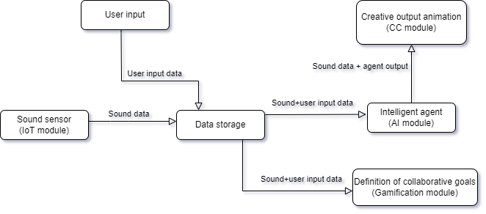
System structure

Slide 9
System structure - iOt module
Sound sensor;
Amplitude readings grouped by a time period (few minutes);
Max amplitude and average;
This data will be sent each time period to be stored on a server by HTTP requests.
Will be used an Arduino board to read the data from the sensor, apply the grouping logic and make the request to the server.

Slide 10
System structure - AI module
Will be created an intelligent agent to decide if the sound sensor readings iares going to be considered stressful or not stressful situations by the creative module.
The JS library tau-prolog (available in http://tau-prolog.org/) will be used to build the agent in order to better integrate with the creative module.

Slide 11
System structure - AI module
The inputs for the agent will be:
Sound readings grouped by time period;
Input made by the users about their perception.
The agent will compare maximum amplitudes with the averages and determine the level of sound intermittency. This intermittency level, calibrated by the user perception, will define the periods with more stress.

Slide 12
System structure – CC Module
Use of generative art techniques to create an output based on the input data that represents the user’s environment mood on that period of time.
The animation will be an stylized particle system influenced by 2 dimensions:
The maximum amplitudes will define the agitation of the particles;
The stress level returned by the intelligent agent will “heat” the color gradient.

Slide 13
System structure – CC Module
influenced
The p5.js (available in https://p5js.org/) was chosen to implement the creative output animation because the user interaction with the system will be through a web application.

Slide 14
System structure – Gamification Module
The gamification module will be implemented with forms on the web application to input the goals and pages to display the completed goals, streaks and users comparation.

Slide 15
conclusions
As the world discuss a global epidemic of mental illness, campaigns or experiments to raise awareness about mental health care become important tools to make people reflect about their mental state and seek for help.
In this cases, awareness and prevention could play a main role on avoiding extreme mental health problems and affecting others on the same environment before seeking for professional help and adapting lifestyle changes.

Slide 16
Future work
A next step on this project could be complementing the input data with another sensors (like heart rate monitors, for example) and data from health APIs(like Apple Health).
Adding to that, a more deep research could be done on how to measure stress to add more complex and realistic rules to the intelligent agent.

